Slide 1
Fish Weight Prediction
Malka, Salena, Joyce, Olivia, Gwen, Xindi
Notes:
Everyone says their own name

Slide 2
Introduction
To predict fish weight, we split the given dataset into training and validation set. The test set is used to demonstrate the models
The weight is predicted using 3 length measures, the height, and width.
Notes:
Olivia - To predict the fishes weights, we split the dataset that we were given into a training set, which is the initial dataset used to train the machine learning model, and a validation set, to improve the model’s performance and prevent overfitting. We used a test set to evaluate the performance of the final trained model. The fishes weights are predicted using lengths 1, 2, and 3, and their heights and widths.

Slide 3
Model and Loss Functions
Lasso
Ridge
Linear Regression
Penrose Manual
Polyfit
Compared their root mean squared errors
Notes:
Olivia - We used 5 models to predict the fishes weights. A linear regression model assumes a linear relationship between the inputs and the target, and finds the line of best-fit. Lasso is a type of linear regression that uses L1 regularization, which makes some of the coefficients exactly zero, and Ridge uses L2 regularization, which makes coefficients small and evenly distributed. The Penrose model is calculated manually, and the Polyfit model fits a polynomial function to our data points.

Slide 4
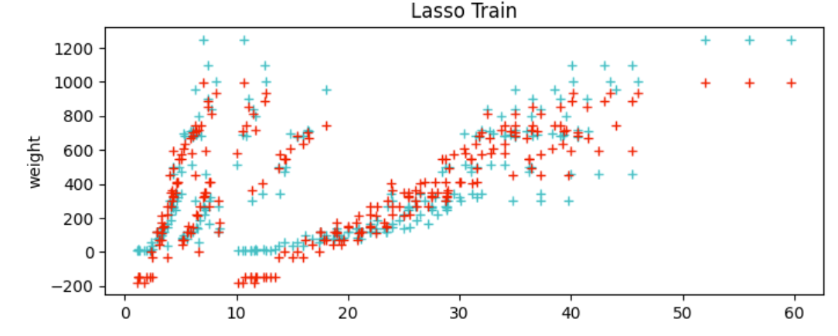
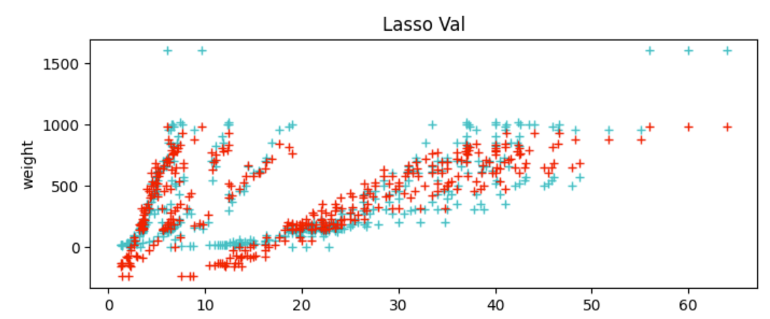
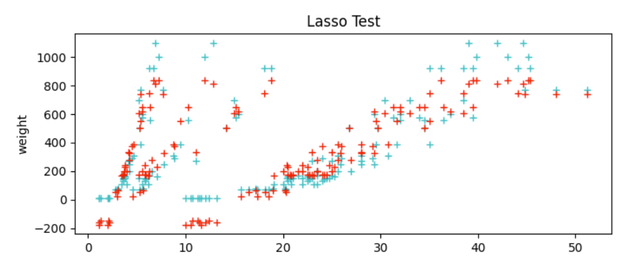
Model Performance: Lasso
RMSE Train: 447.12
RMSE Val: 459.72
RMSE Test: 437.36
Notes:
MALKA - This is the lasso model, which assists in the elimination of irrelevant parameters, thus helping in the concentration of selection and regularizes the models.
Lasso doesn’t work that well because it doesn’t work well without outliers that are important.
So, for our results, we got RMSE train: 447.12 RMSE Val: 459.72 RMSE Test: 437.36.

Slide 5
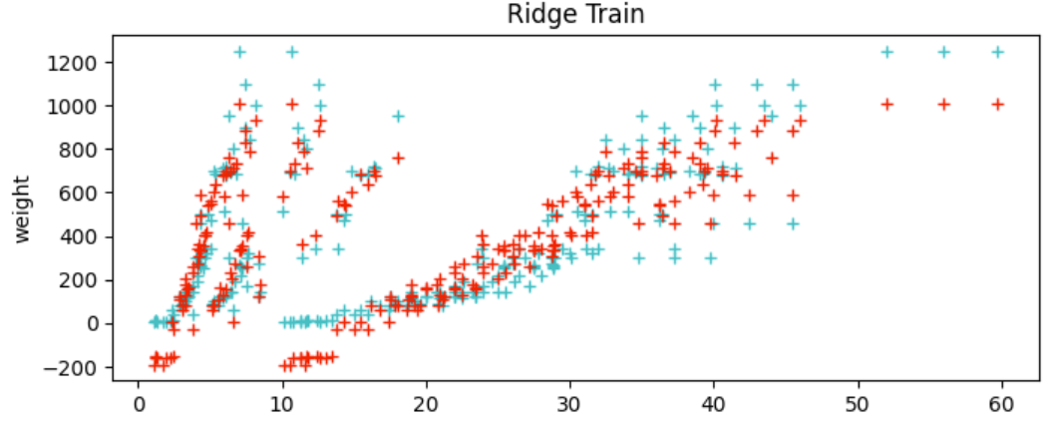
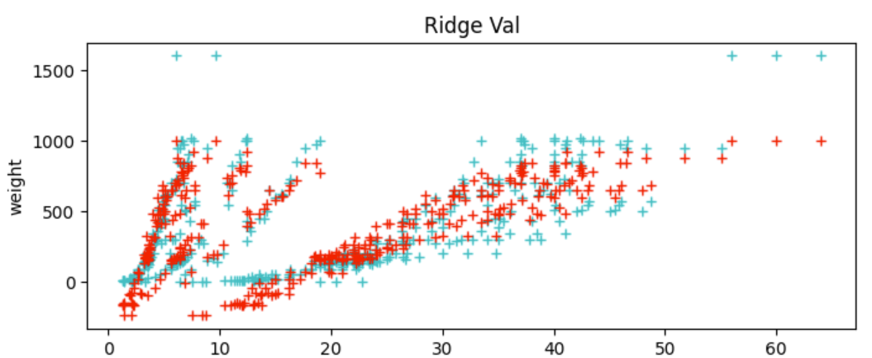
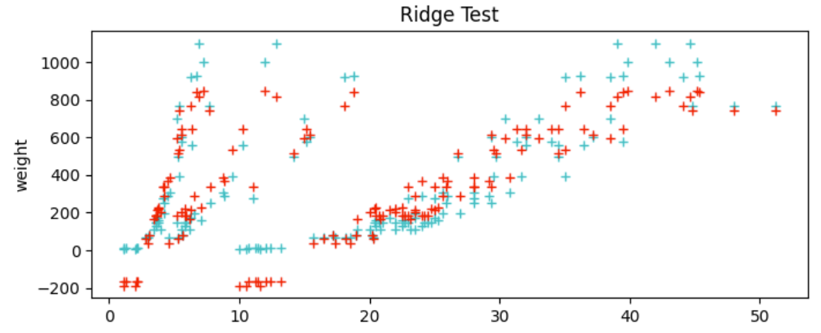
Model Performance: Ridge
RMSE Train: 102.89
RMSE Val: 123.11
RMSE Test: 106.69
Notes:
XINDI - Ridge uses L2 regularization, which squares the regularization term. This gives the outliers more impact on the model, which makes it better in this case because the outliers in this case are important to the data set. This works better than lasso because lasso uses L1 regularization, which takes the absolute value of the regularization term, giving the outliers less power. This makes Ridge 4x better than Lasso in this case.

Slide 6
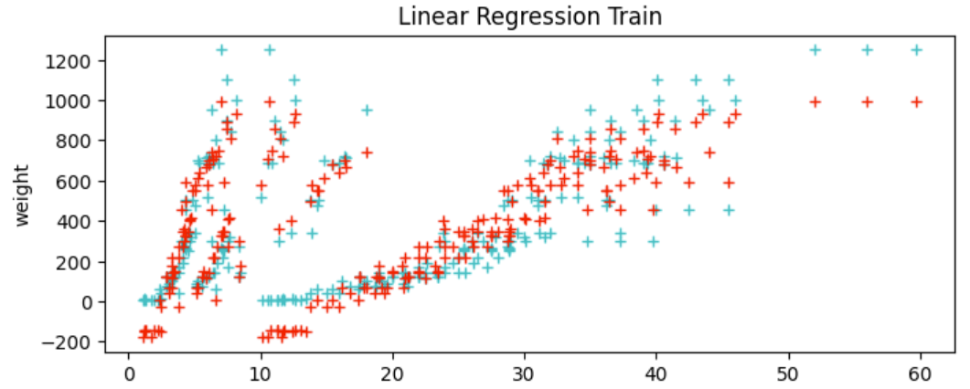
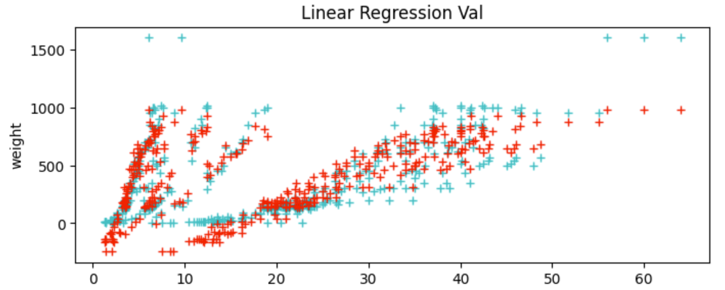
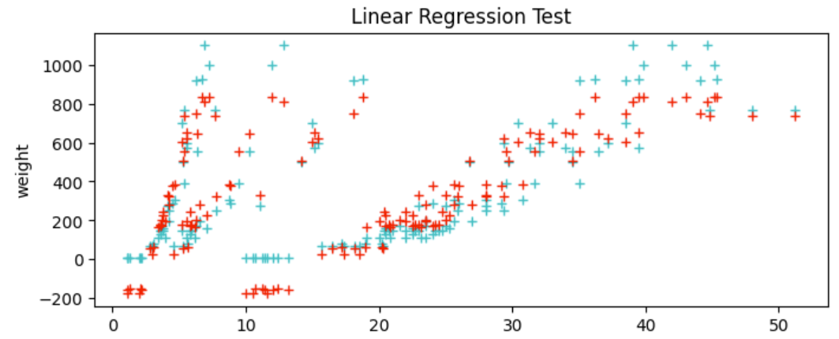
Model Performance: Linear Regression
RMSE Train: 102.26
RMSE Val: 127.71
RMSE Test: 107.66
Notes:
SALENA:
When we talk about regression, it means that the model predicts the continuous output based on an independent input, such as the example of predicting temperature by degrees fahrenheit.
Linear regression is when a data set can be represented as a function of features to find the best fit. We had a framework of the model and found parameters such as weight.
All of our results are RMSE, not MSE, which means that they’re all square-rooted. Our RMSE values suggest that this model is accurate from its fairly low rmse value
*STATE RMSE VALUES*

Slide 7
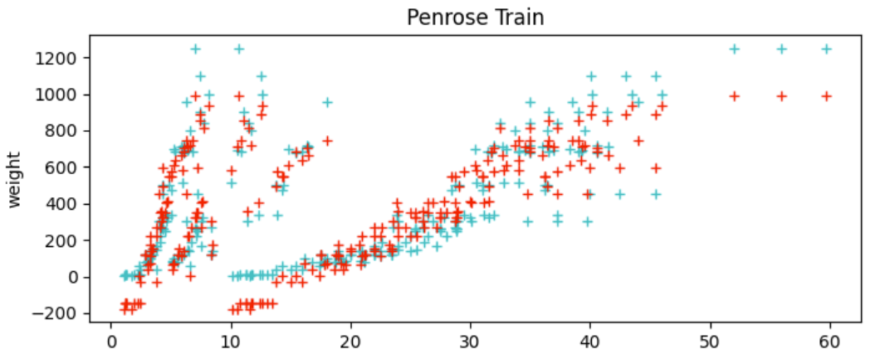
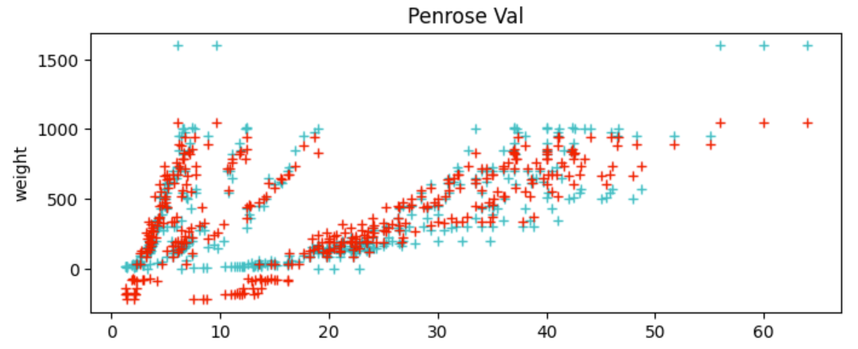
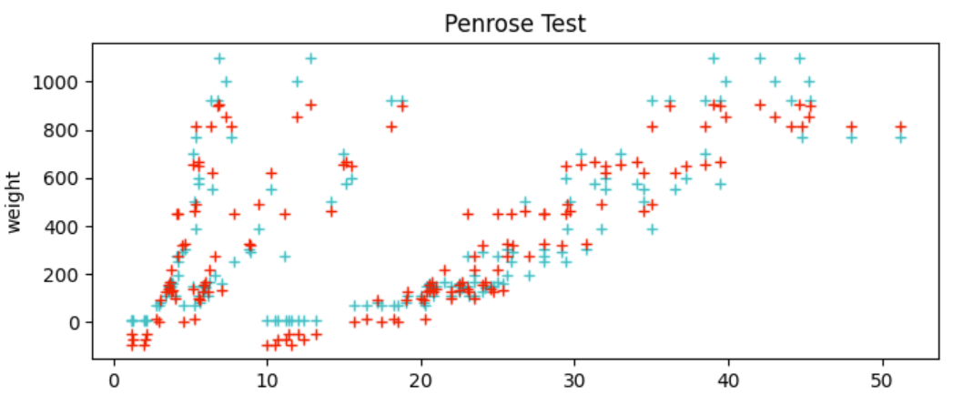
Model Performance: Penrose
RMSE Train: 102.26
RMSE Val: 115.36
RMSE Test: 84.43
Notes:
GWEN - This model uses the same principles as linear regression except calculated manually. This is shown by the RMSE on training- the exact same as the sk linear regression model. However due to the data distribution, this one performed better on the other datasets than the imported one from sklearn. It creates a basic design matrix by adding a column of ones to preserve the bias and then multiplying it by the weights- calculated using the moore-penrose pseudoinverse. This generates the predictions using theoretically the ideal impacts of each feature. 102 115 84

Slide 8
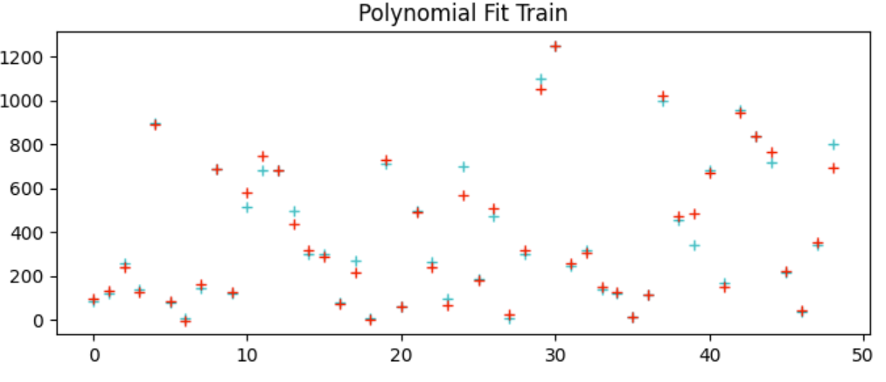
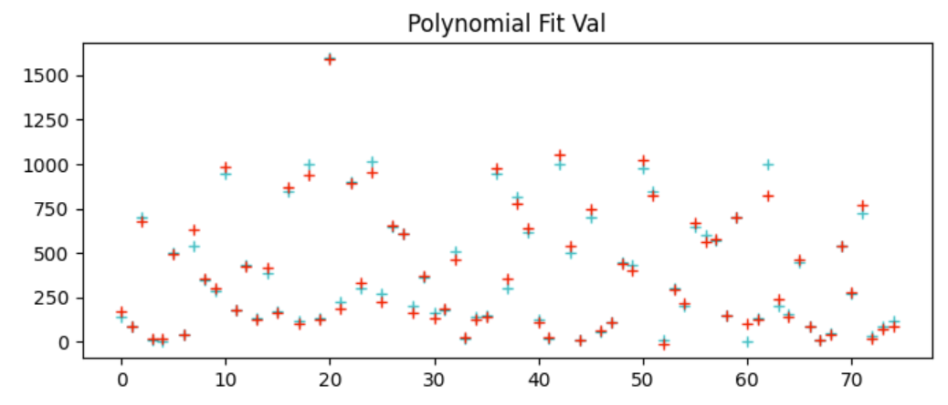
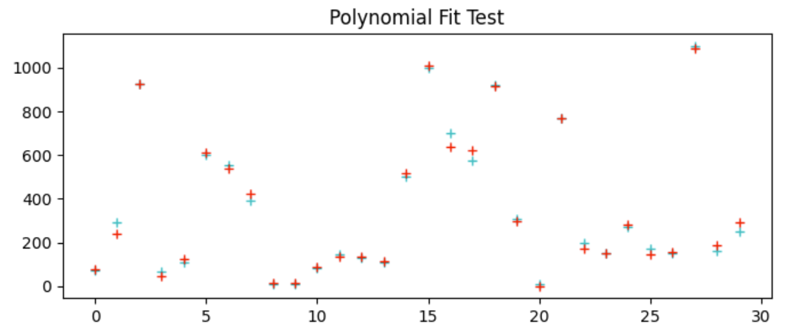
Model Performance: Polyfit
RMSE Train: 39.82
RMSE Val: 36.25
RMSE Test: 22.84
Notes:
JOYCE - This is the poly fit method that makes a matrix which iterates through the features for each power before doing another five (length1, length2, length3, height, and width) for the next power. This matrix has five times the columns of a basic poly fit, for each of the features. This repeats and we decided to use the 4th order. All in all, it raises everything to the model order and concatenates it to the design matrix. As we can see on the graph it compares the y hat values values to the y values. The blue stars show the predicted values while the red stars show the real values. It works the best because out of all the graphs it uses the weights most appropriately

Slide 9
Challenges and Resolutions
Google Colab Collaboration Issues → Create separate files to code in, and then copying it into a google doc
Lasso not taking outliers into account → increasing the number of iterations from 1,000 to 10,000
Polyfit Graph → loop is functional
Model order and concatenation
Notes:
MALKA - The challenges that we had were google colab, lasso not taking outliners into account, and with the polyfit graph.
With Google Collab - we had a problem with creating separate files, but we resolved this issue by copying out code into a google doc
With Lasso, we had an issue with it not taking outliers into account, so we increased our number of iterations from 1,000 to 10,000
For the polyfit graph we had difficulty generating the for loop. But with help, I was able to loop through everything. Although, it does not match the order that was provided as guidance, it is still functional.

Slide 10
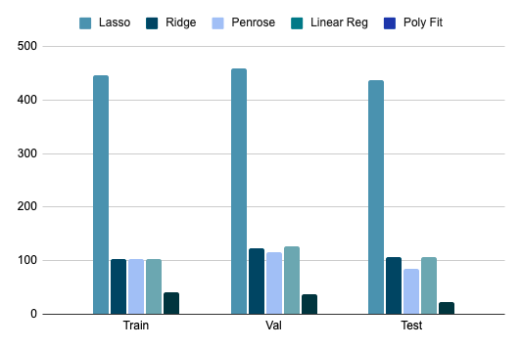
Conclusion
Poly Fit
Penrose Manual
Ridge
Linear Regression
Lasso
Notes:
MALKA - For our conclusion, we decided to make a ranking, and this is what we had. Number one was Polyfit; as it had the best results by a longshot, second, we put Penrose, third was ridge, fourth was linear regression, and last place was lasso; with the worst results. To the side, we made a bar graph to depict our results, so it’s each model, and their RMSE results for Train, Val and Test.

Slide 11

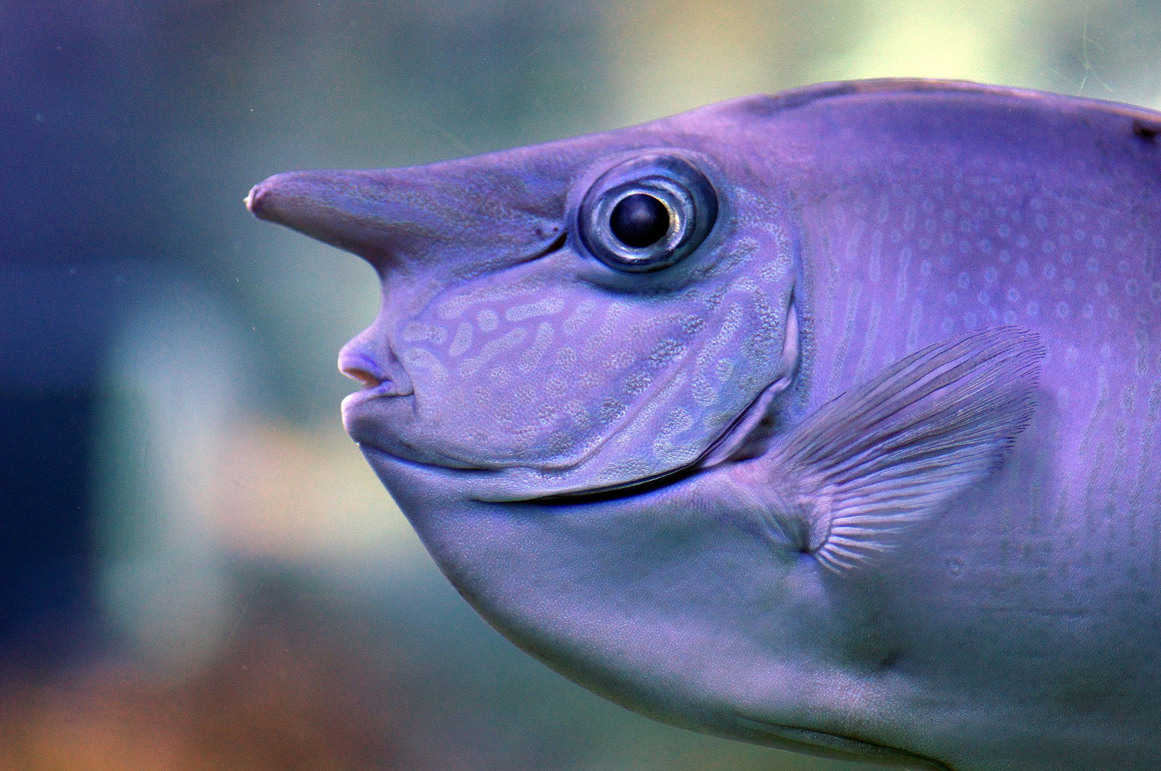
Thank You!

